Slide 1
CSCE 1035 Computer Programming I Chapter 16 Searching and Sorting Algorithms
University of North Texas

Slide 2

16.1 Searching Algorithms

Slide 3

Linear Search
Searching is the general problem of finding a specific item within a collection of items
A linear search is the simplest and most obvious way to search
A linear search looks through a list one item at a time until the item is found or the end of the list is reached
>>> def linear_search(numbers, key):
... for i in range(len(numbers)):
... if numbers[i] == key:
... return i
... return -1 # not found
...
>>> linear_search([0,10,20,30,40],30)
3
>>> linear_search([0,10,20,30,40],25)
-1
The Python in and index operations both implement linear searching algorithms

Slide 4


Algorithm Runtime
What is the worst-case running time of a linear search?
If there are n items in the list, then the algorithm may have to check each one so it has a running time of n number of steps
So if the time for each comparison is 1 microsecond (µs), then a worst-case linear search would take 1 µs times n
This is not bad, unless you need to do a lot of searching
If you think about looking up numbers in a phone book or words in a dictionary with millions of entries, you can see how much having sorted information can speed up the search
In this case, there are better algorithms that can be used

Slide 5
16.2 Binary Search

Slide 6
Binary Search
A binary search locates the target value in a sorted list by successively eliminating half of the list from consideration
Since the list is sorted, if we look at one item, we know that every item after it is larger and every item before it is smaller
So, if we look at the item in the middle of the list, we can know which half of the list the item we are looking for would be in
Suppose we are searching the list below for the value 42. How many elements would we need to examine?
index | 0 | 1 | 2 | 3 | 4 | 5 | 6 | 7 | 8 | 9 | 10 | 11 | 12 | 13 | 14 | 15 | 16
value | -4 | 2 | 7 | 10 | 15 | 20 | 22 | 25 | 30 | 36 | 42 | 50 | 56 | 68 | 85 | 92 | 103
min
mid
max

Slide 7
Binary Search
>>> def binary_search(numbers, key):
... low = 0
... high = len(numbers) - 1
... while high >= low:
... mid = (high + low) // 2
... if numbers[mid] < key:
... low = mid + 1
... elif numbers[mid] > key:
... high = mid - 1
... else:
... return mid
... return -1 # not found
...
>>> binary_search([-4,2,7,10,15,20,22,25,30,36,42],25)
7
>>> binary_search([-4,2,7,10,15,20,22,25,30,36,42],18)
-1

Slide 8
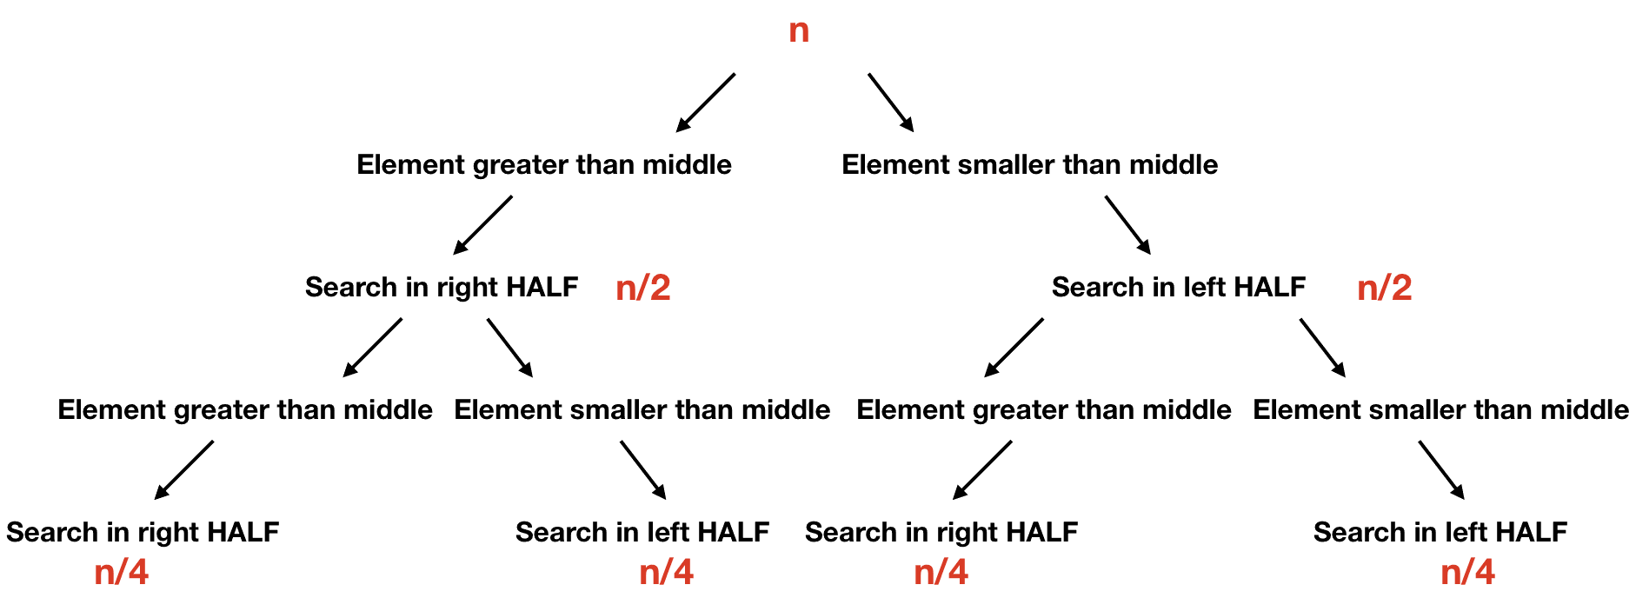
Binary Search Efficiency
Due to the strategy of halving the possibilities with each comparison, the algorithm has a running time of log₂ n number of steps
This is much faster than linear search, but to use binary search you must maintain a sorted list

Slide 9
Binary Search Efficiency
Suppose you have the New York City phone book containing 12 million names
You could walk up to a New Yorker and, assuming they are listed in the phone book, tell them the following:
I'm going to try guessing your name. Each time I guess a name, you tell me if your name comes alphabetically before or after the name that I guess.
How many guesses will you need?
Based on our assertion, we know this to be log₂ 12,000,000, which evaluates to about 24 guesses
Compared to an average 6,000,000 guesses using a linear search!

Slide 10
16.5 Sorting: Introduction

Slide 11
Sorting by Swapping
Sorting involves rearranging the values in a list or collection into a specific order, so that its values are in increasing or decreasing order, usually into their natural ordering
Sorting algorithms typically operate using a swap function to exchange the positions of two items in a list
>>> def swap(list1, i, j):
... temp = list1[i]
... list1[i] = list1[j]
... list1[j] = temp
... return list1
...
>>> my_list = [30, 22]
>>> sorted_list = swap(my_list, 0, 1)
>>> print(sorted_list)
[22, 30]

Slide 12
16.6 Selection Sort

Slide 13
Selection Sort
The selection sort orders a list of values by repeatedly putting the smallest or largest unplaced value into its final position
Look through the list to find the smallest value
Swap it so that it is at index 0
Look through the list to find the second smallest value
Swap it so that it is at index 1
…
Repeat until all values are in their proper places
6, 34, 12, 7, 3, 26, 19 Smallest: 3 Swap: 3 and 6
3, 34, 12, 7, 6, 26, 19 Smallest: 6 Swap: 6 and 34
3, 6, 12, 7, 34, 26, 19 Smallest: 7 Swap: 7 and 12
3, 6, 7, 12, 34, 26, 19 Smallest: 12 Swap: 12 and 12
3, 6, 7, 12, 34, 26, 19 Smallest: 19 Swap: 19 and 34
3, 6, 7, 12, 19, 26, 34 Smallest: 26 Swap: 26 and 26
3, 6, 7, 12, 19, 26, 34

Slide 14
Selection Sort Algorithm
>>> def selection_sort(numbers):
... for i in range(len(numbers) - 1):
... # Find index of smallest remaining element
... index_smallest = i
... for j in range(i + 1, len(numbers)):
... if numbers[j] < numbers[index_smallest]:
... index_smallest = j
... # Swap numbers[i] and numbers[index_smallest]
... temp = numbers[i]
... numbers[i] = numbers[index_smallest]
... numbers[index_smallest] = temp
...
>>> my_list = [7, 4, 13, 9, 5, 15, 1]
>>> selection_sort(my_list)
>>> print(my_list)
[1, 4, 5, 7, 9, 13, 15]

Slide 15
Selection Sort Efficiency
In the selection sort algorithm, we start by finding the smallest item, then finding the smallest of the remaining items, and so on
Suppose we start with a list of size n
To find the smallest element, the algorithm inspects all n items
The next time through the loop, it inspects the remaining n-1 items
The total number of iterations is
n + (n-1) + (n-2) + (n-3) + … + 2 + 1
Therefore, the number of comparisons required by selection sort to sort a list of n items is proportional to n(n-1)/2
More simply, we refer to number of steps to be proportional to n²

Slide 16
16.7 Insertion Sort

Slide 17

Insertion Sort
The insertion sort orders a list of values by repeatedly inserting a particular value into a sorted subset of the list
Pick and item and insert it into its proper place in a sorted sublist
Initially p = 1
Let the first p elements be sorted
Insert the (p+1)^{th} element into the sorted sublist
Increment p and repeat step 3 until all items have been sorted
6, 34, 12, 7, 3, 26, 19 Insert 34 after 6
6, 34, 12, 7, 3, 26, 19 Insert 12 after 6
6, 12, 34, 7, 3, 26, 19 Insert 7 after 6
6, 7, 12, 34, 3, 26, 19 Insert 3 before 6
3, 6, 7, 12, 34, 26, 19 Insert 26 after 12
3, 6, 7, 12, 26, 34, 19 Insert 19 after 12
3, 6, 7, 12, 19, 26, 34

Slide 18
Insertion Sort Algorithm
>>> def insertion_sort(numbers):
... for i in range(1, len(numbers)):
... j = i
... # Insert numbers[i] into sorted part
... # stopping once numbers[i] in correct position
... while j > 0 and numbers[j] < numbers[j - 1]:
... # Swap numbers[j] and numbers[j - 1]
... temp = numbers[j]
... numbers[j] = numbers[j - 1]
... numbers[j - 1] = temp
... j = j - 1
...
>>> my_list = [7, 4, 13, 9, 5, 15, 1]
>>> insertion_sort(my_list)
>>> print(my_list)
[1, 4, 5, 7, 9, 13, 15]

Slide 19
Insertion Sort Efficiency
The number of comparisons required by insertion sort to sort a list of n items is n(n-1)/2
Similar to insertion sort, the number of steps is proportional to n²
However, the more items in the list that are in order, the better insertion sort gets until, in the best case of an already sorted list, the sort’s behavior is linear
In the average case, insertion sort is still quadratic (i.e., n²)

